Slide 1
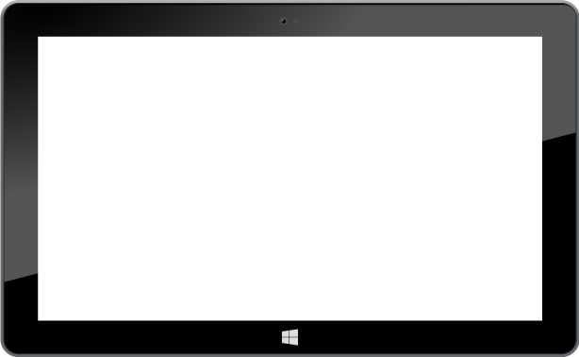
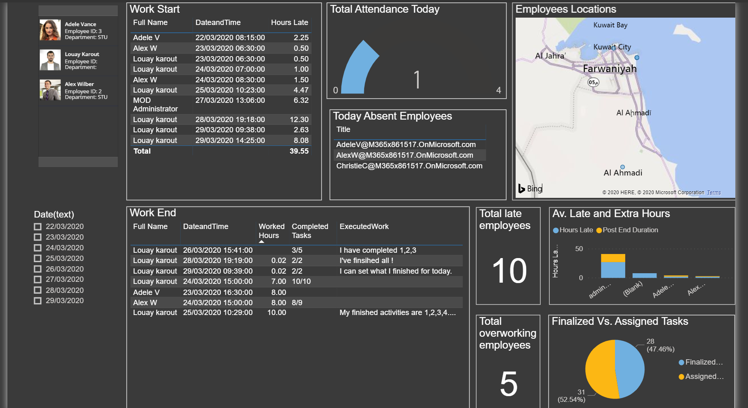

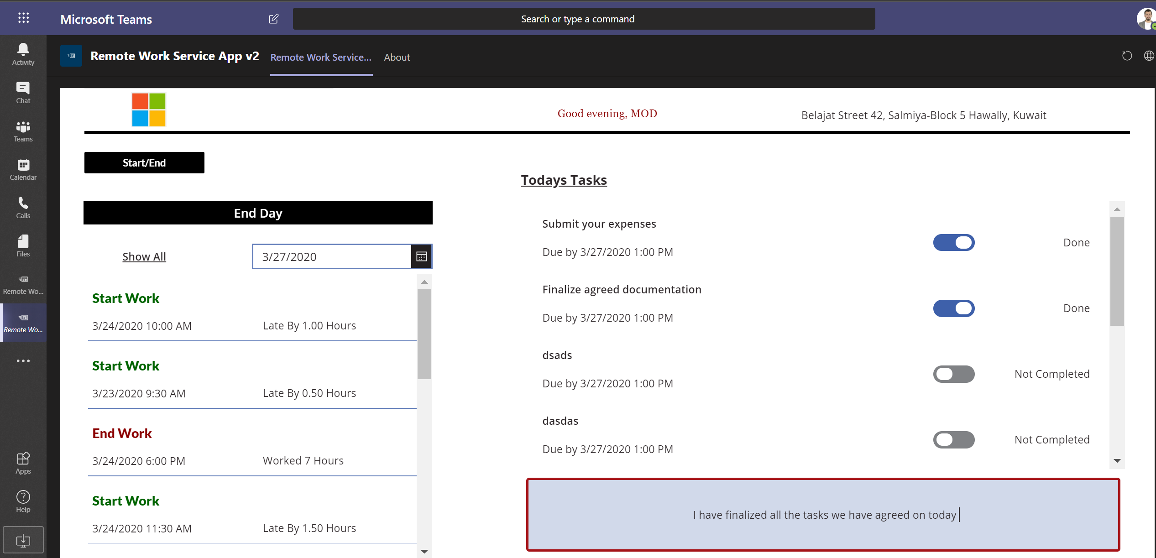
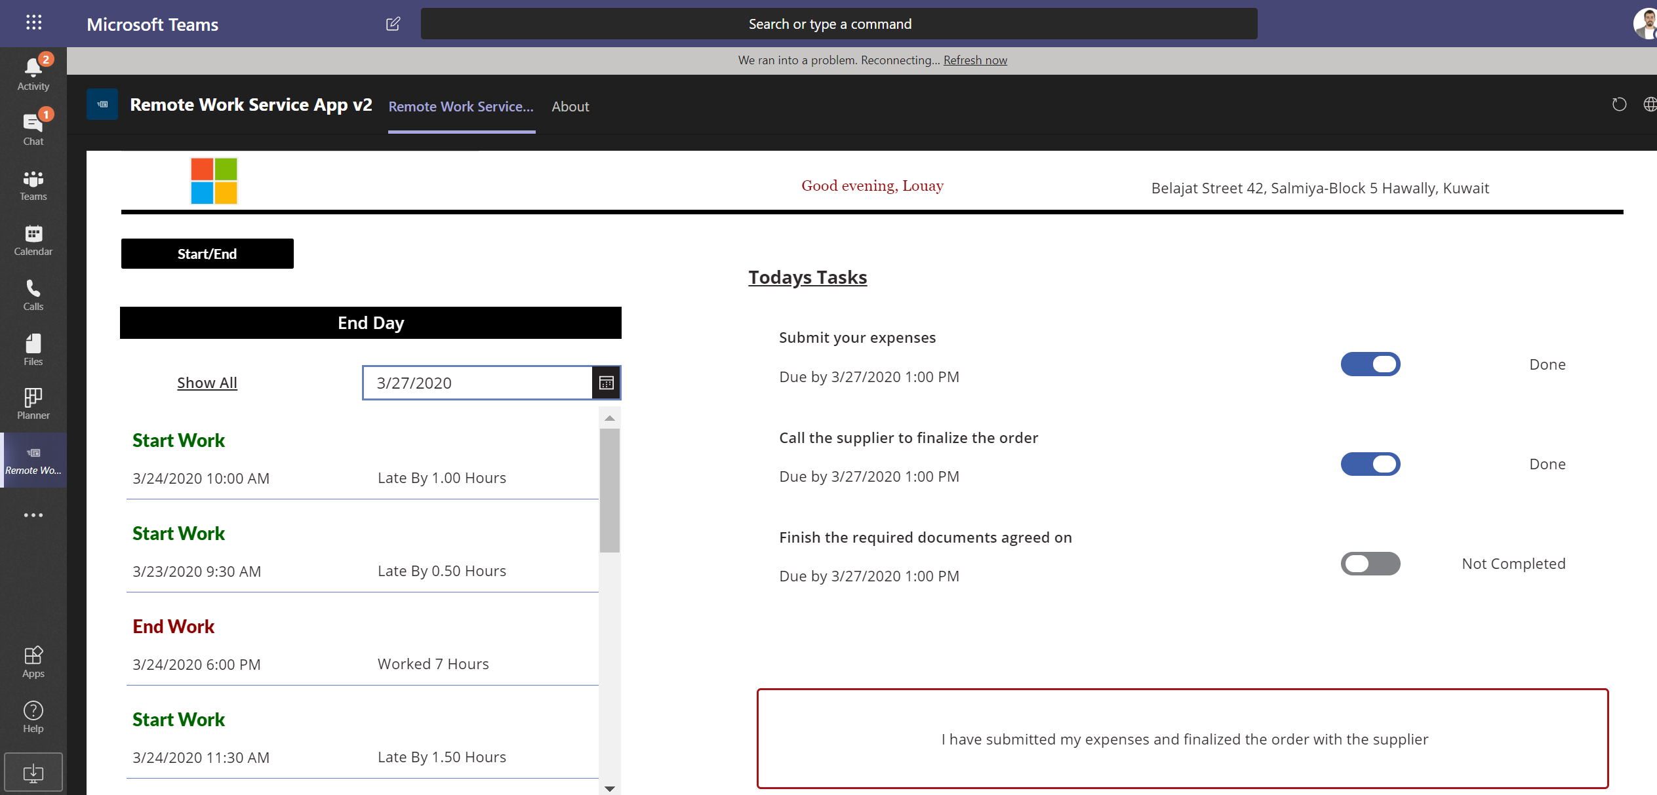
Microsoft Remote Work Management Solution
Enables managers and HR departments to track employee work progress while they are working from home
Notes:
Slide title: Application overview - table of contents
Key points:
In this section, we’ll provide an overview of Dynamics 365 Remote Assist – how it enables collaboration, differences on mobile & HoloLens and integration opportunities

Slide 2
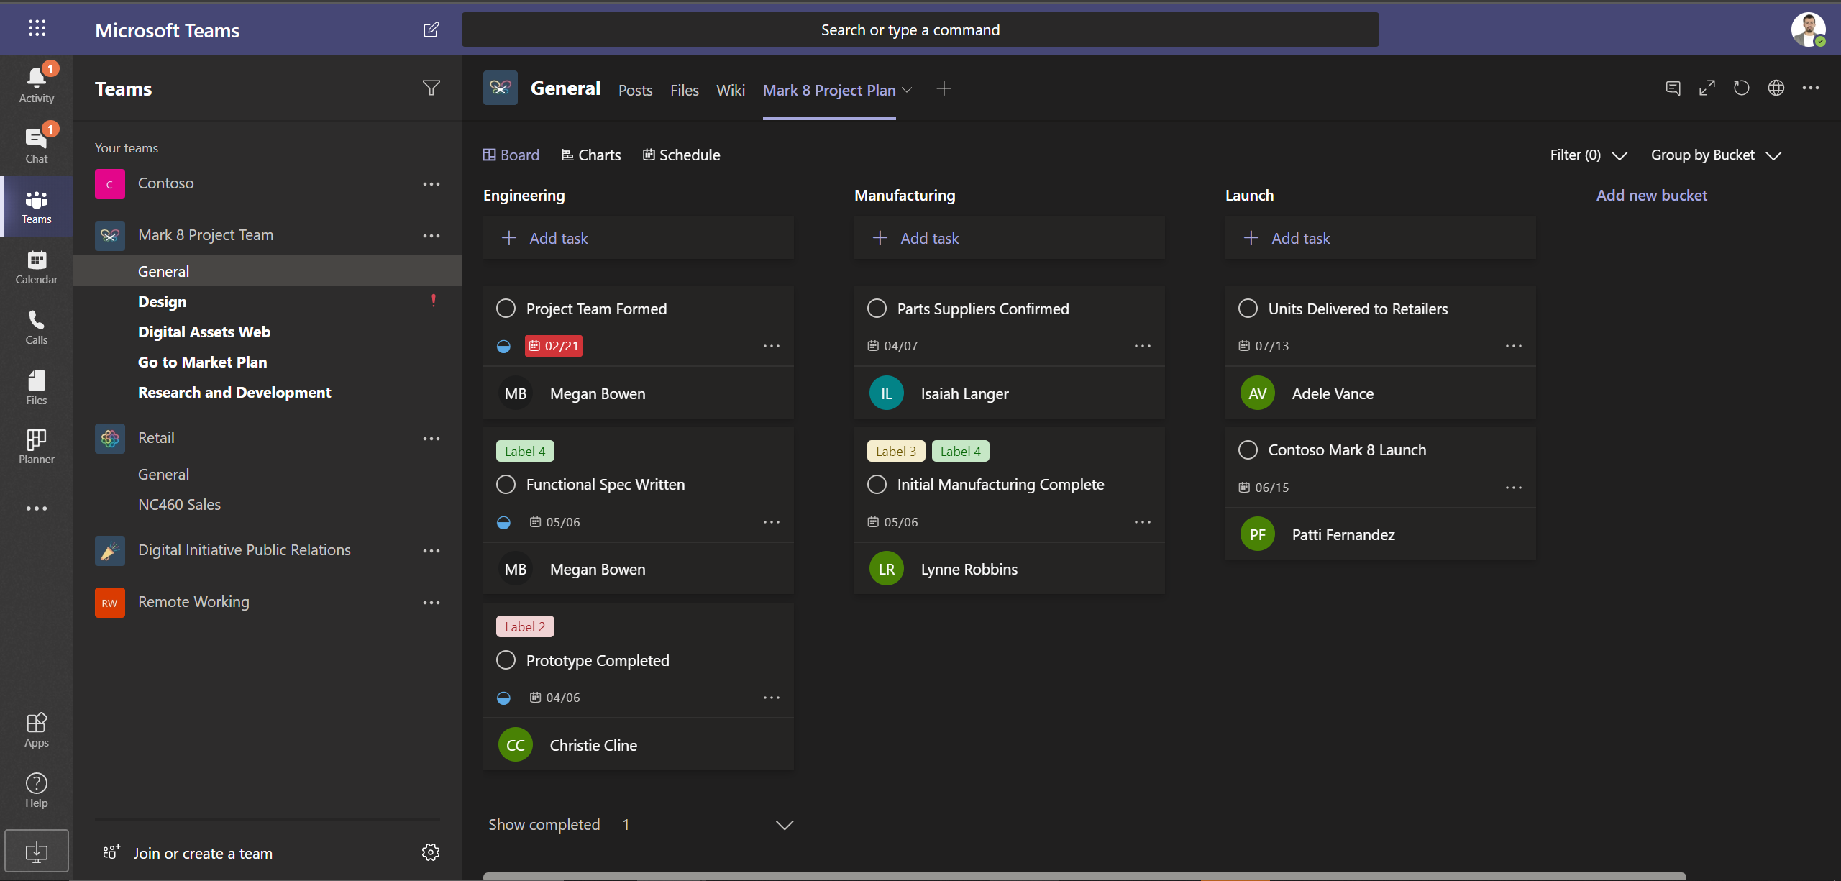
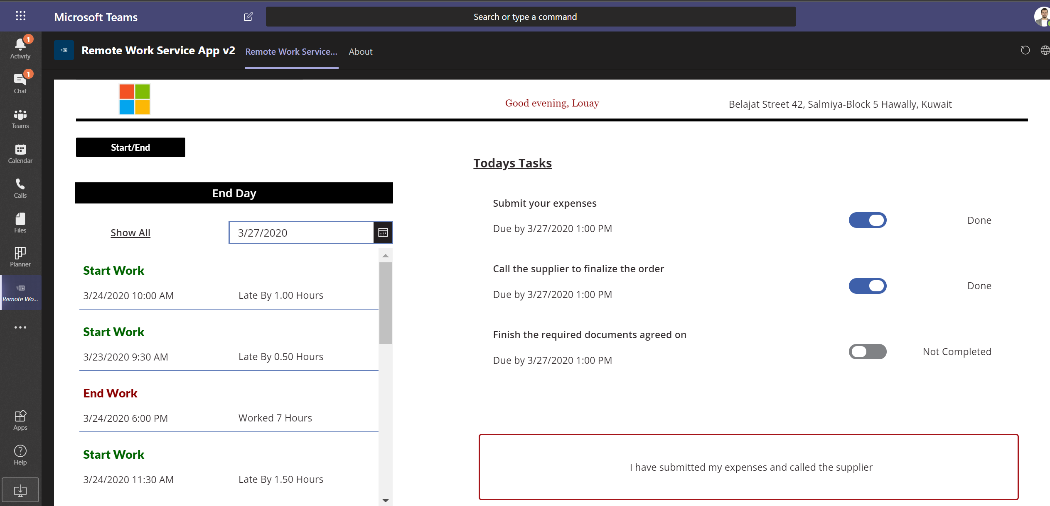
Track your progress
Employees will be able to log in the start/end of their workday and track progress against tasks assigned by their managers

Slide 3
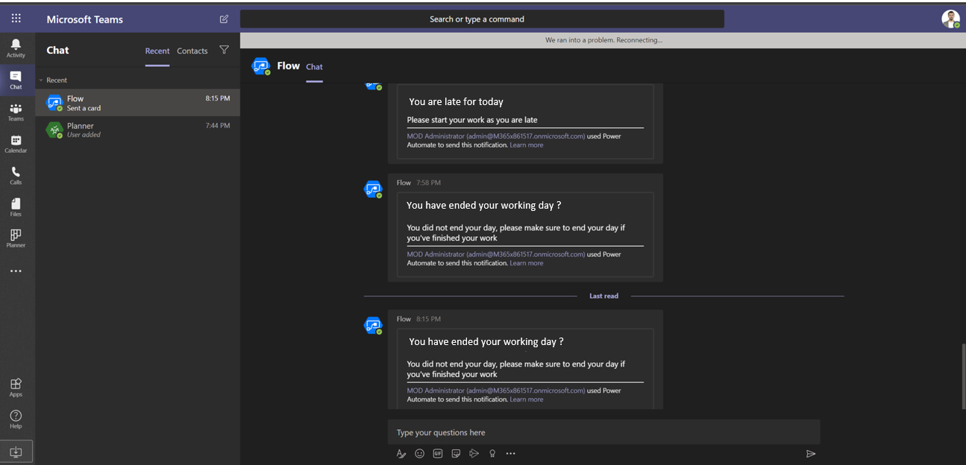
Get alerted when late
You are late for today
An intelligent bot will remind employees to abide by the organization's timings, if their are late to start or finish their day
You have ended your working day ?
You have ended your working day ?

Slide 4
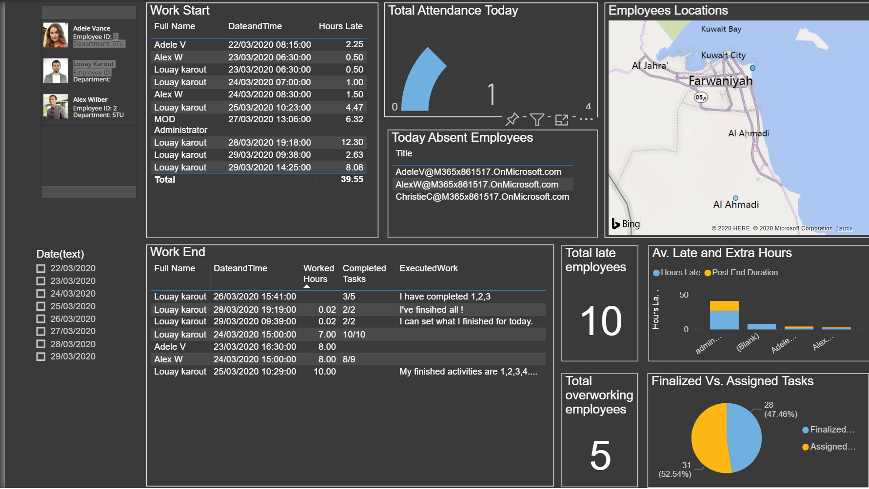

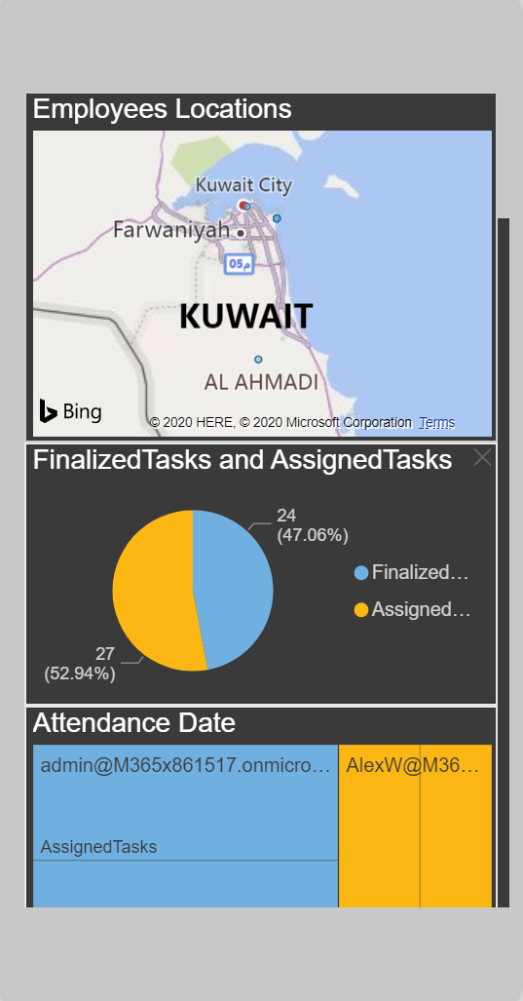
Stay up to date
Managers will gain insights about your employees' attendance and compliance, assignment progress, and locations through out-of-the-box reports

Slide 5
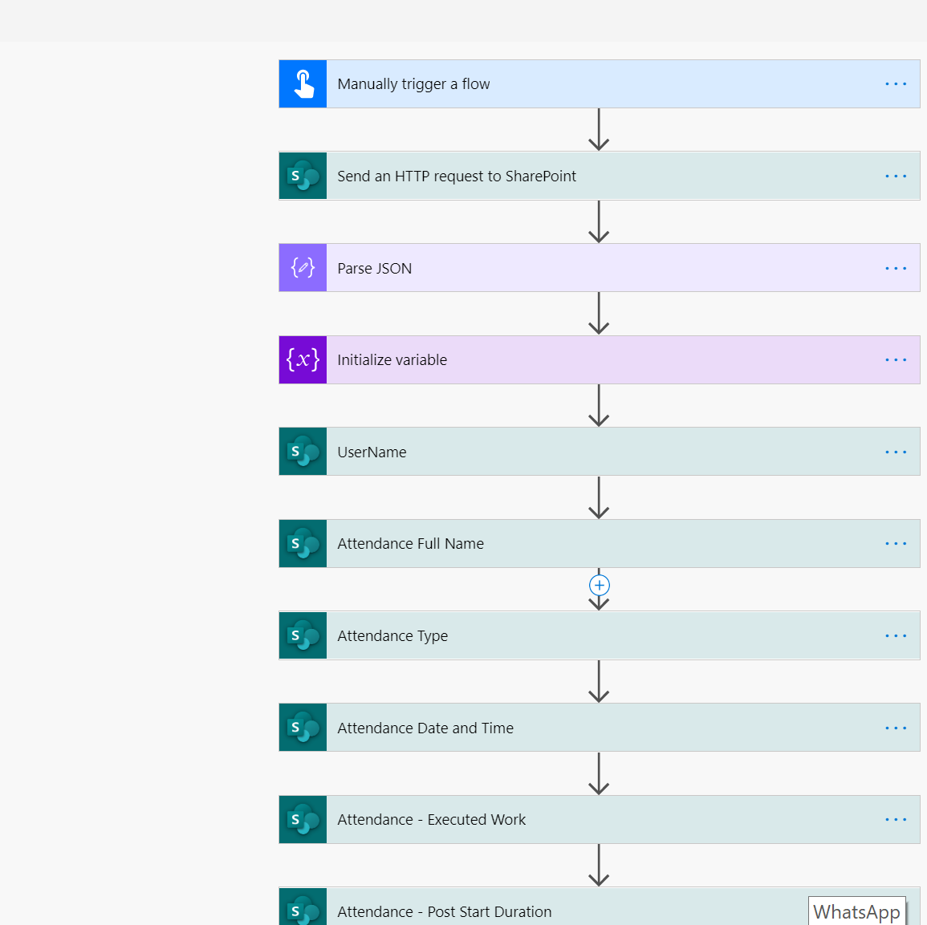
Easily deploy & configure the solution
The solution is equipped with a Power Automate Flow, which you can easily run to configure your SharePoint with the needed data model and a detailed deployment guide for you to setup the solution and leverage it quickly
As the solution is built on top of the low-code platform power platform, you are even able to tailor the solution to your organization with minimum efforts

